Slide 1
On the Robustness of Intrusion Detection System in In-Vehicular Networks
SIL 765 NSS – Final Project Evaluation
Isha Pali (2022QIZ8047)

Slide 2

Contents
Introduction
Security Issues in CAN
NIDS for CAN
Related Work
System Model
Threat Model
Proposed Solution
Evaluation
Conclusion
Future Work
References

Slide 3
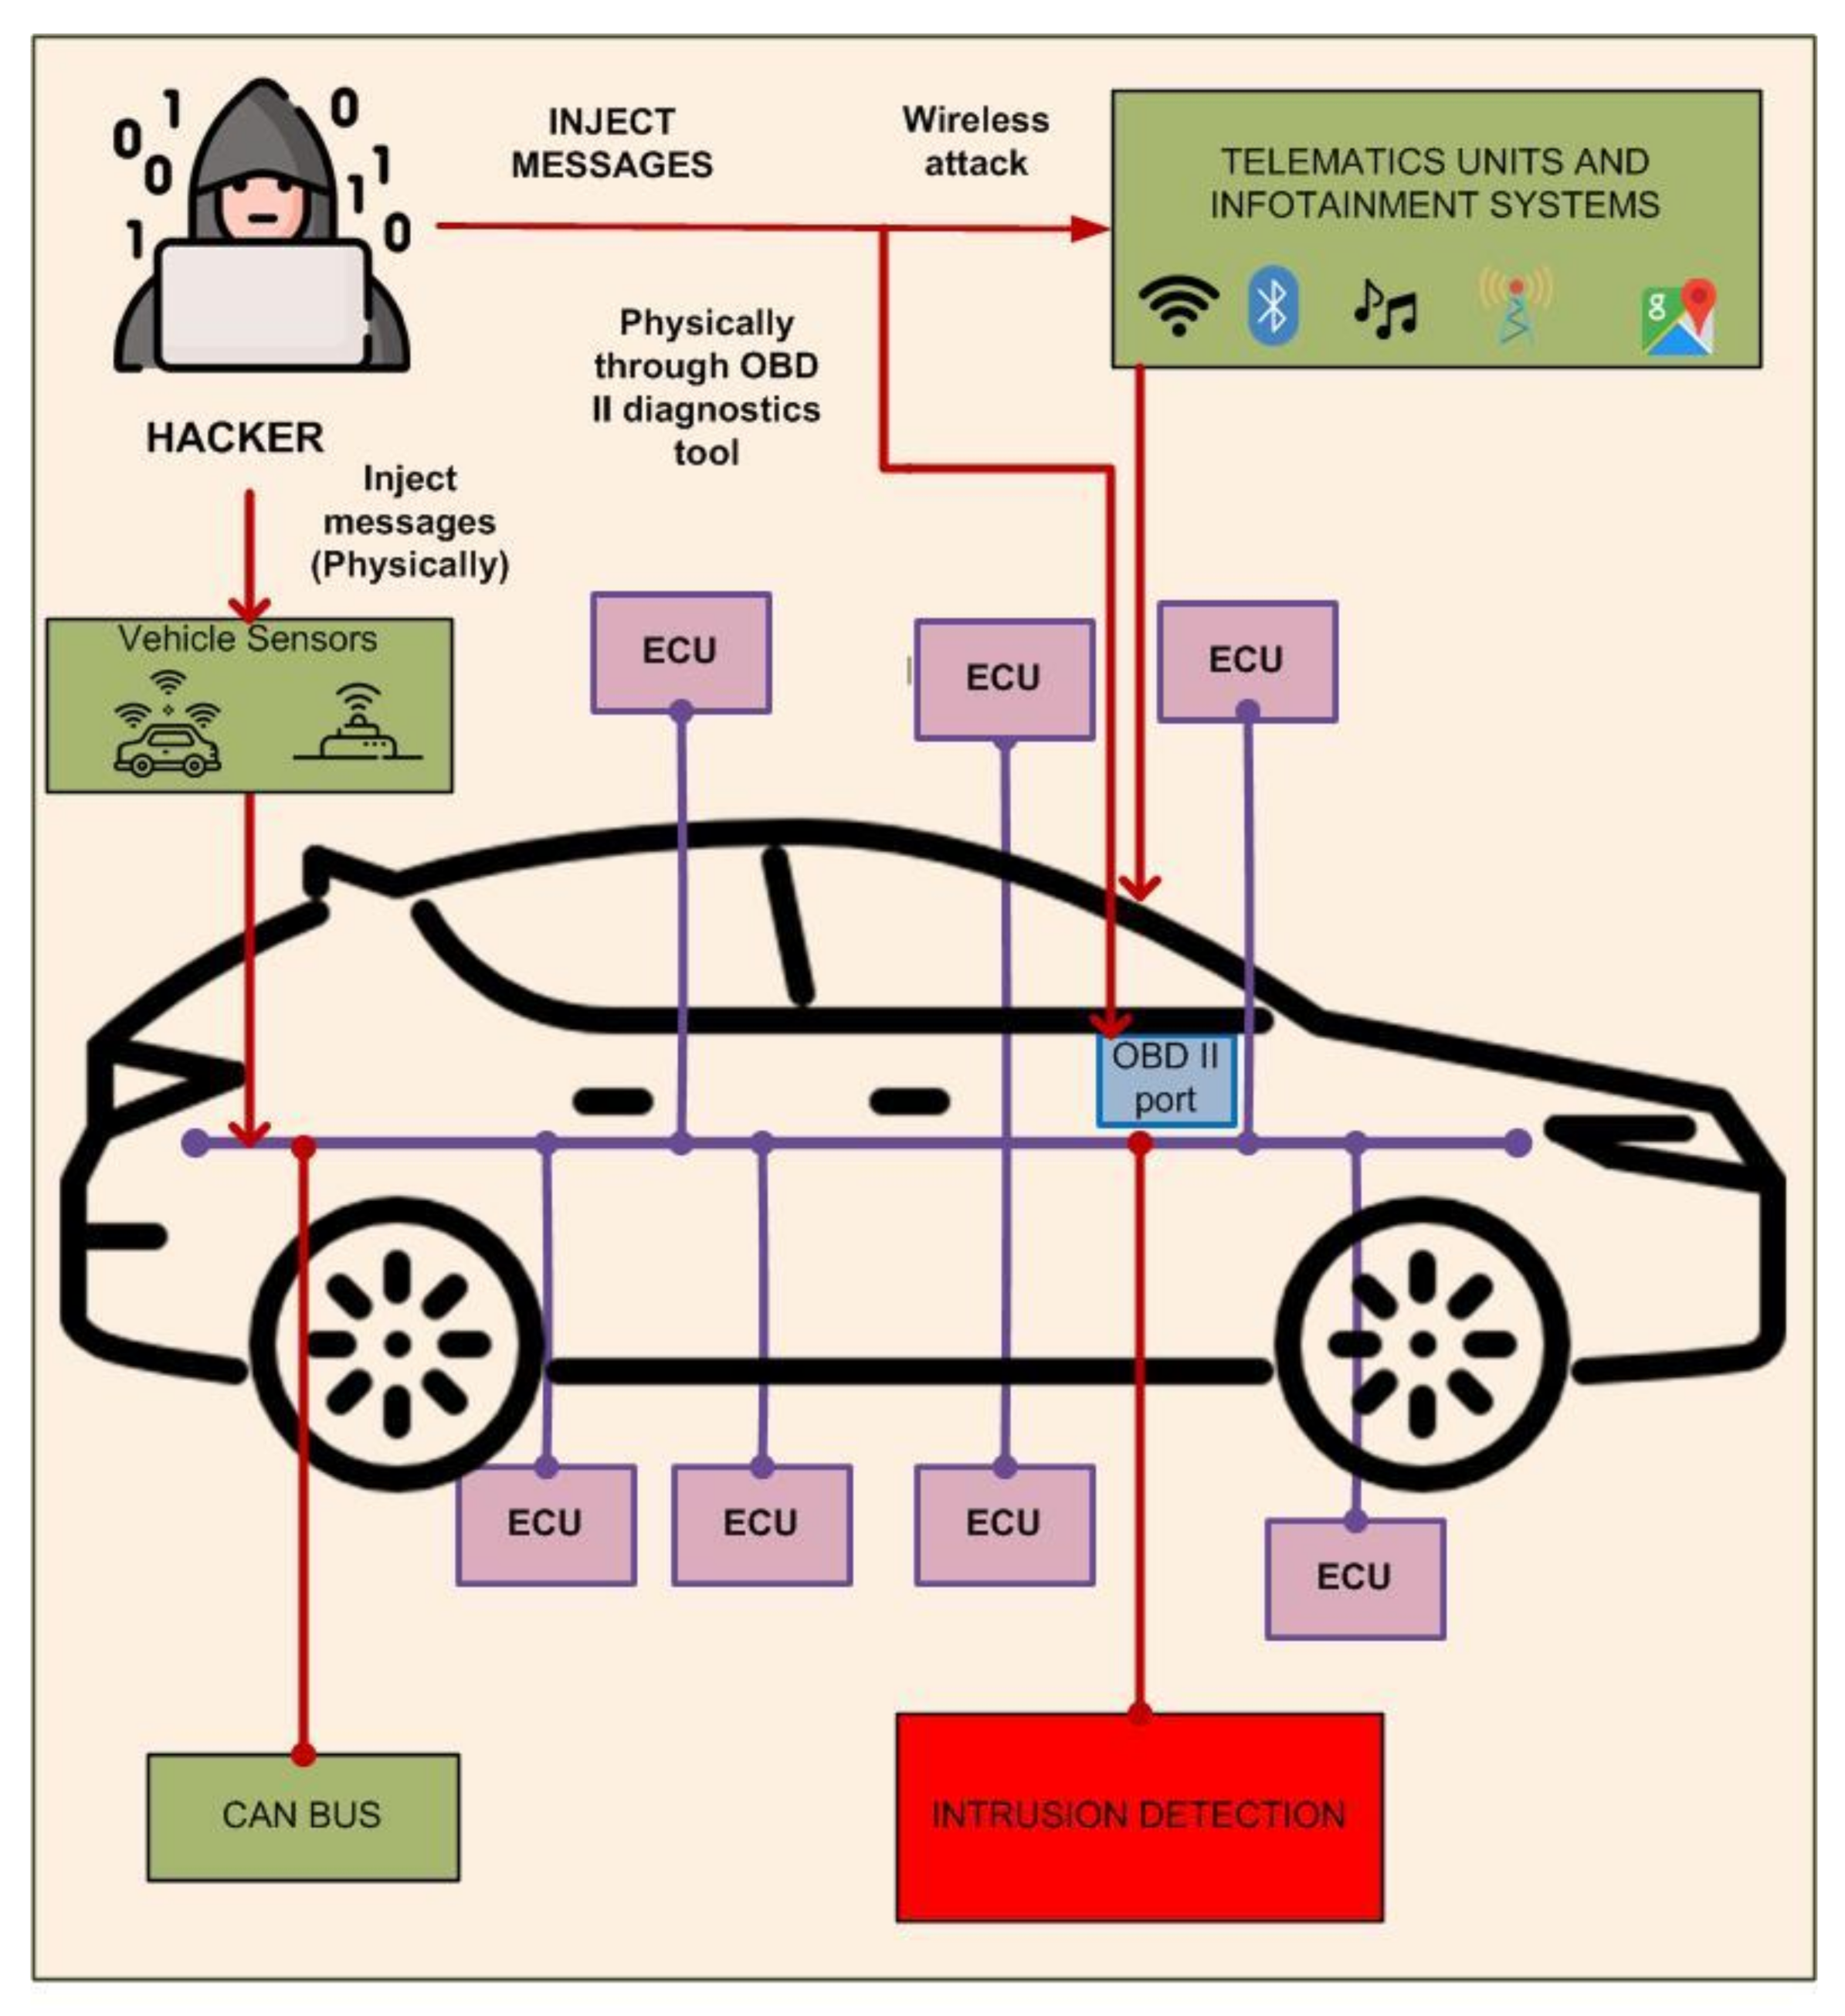
Introduction
ECUs communicate with each other through CAN bus
de facto standard for in-vehicle networks
Message-based broadcast protocol
Attack vectors - OBD-II port and wireless channel
Need for Intrusion detection systems (IDS)
Fig. 1 CAN bus system [2]

Slide 4
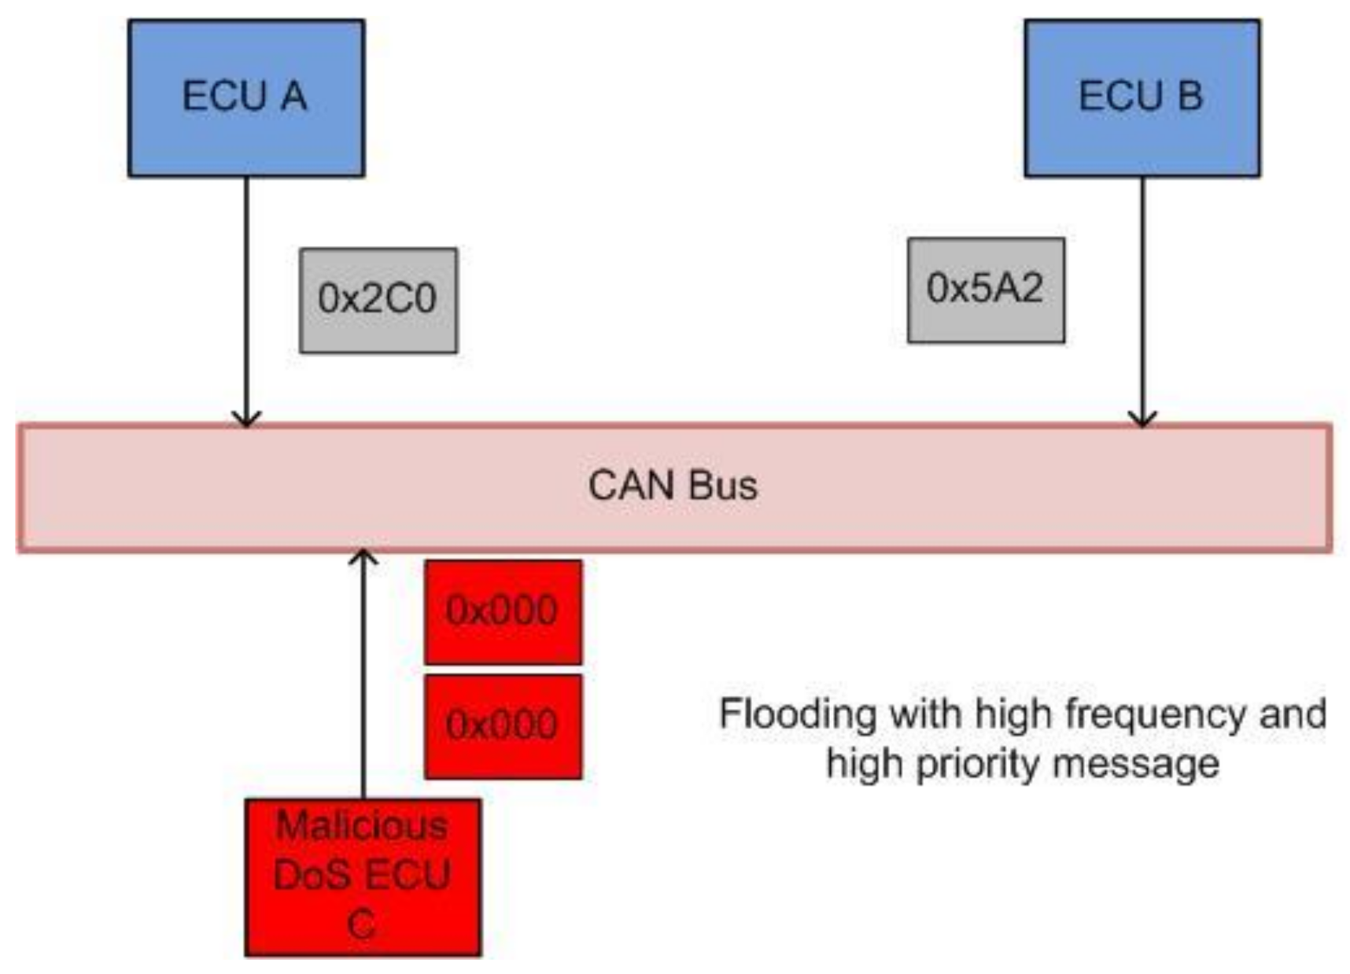
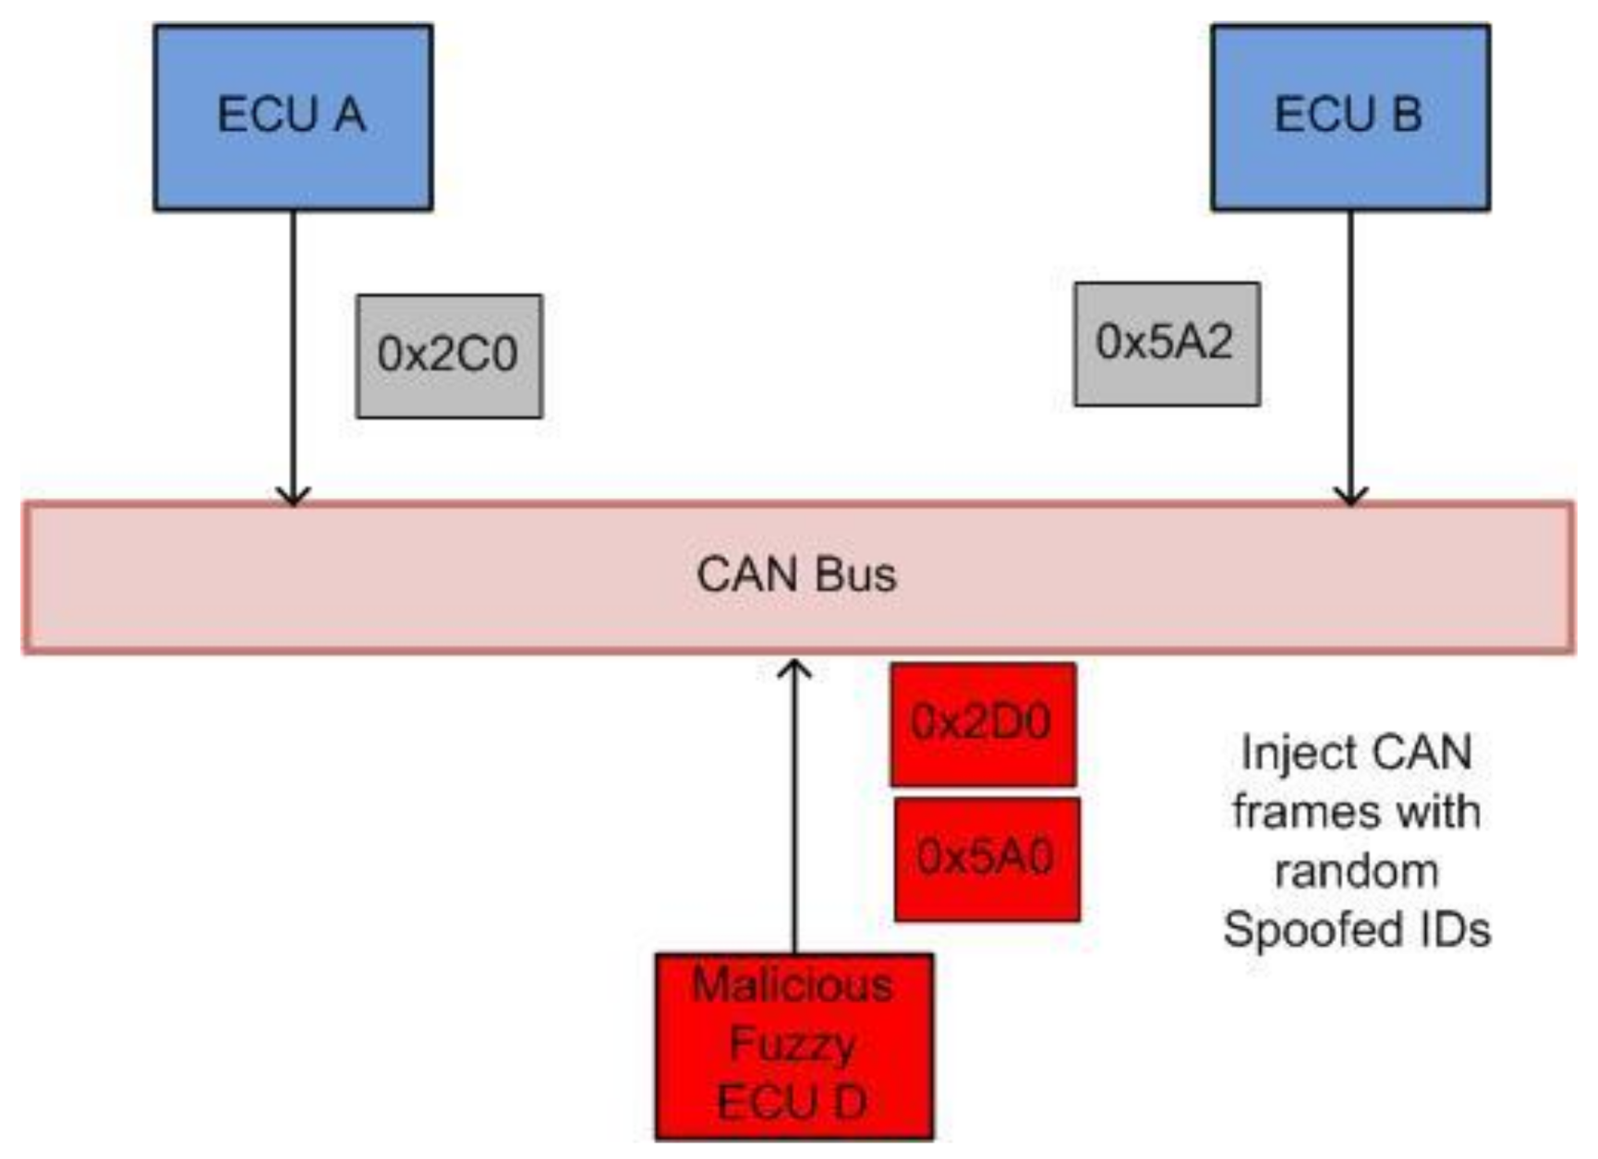
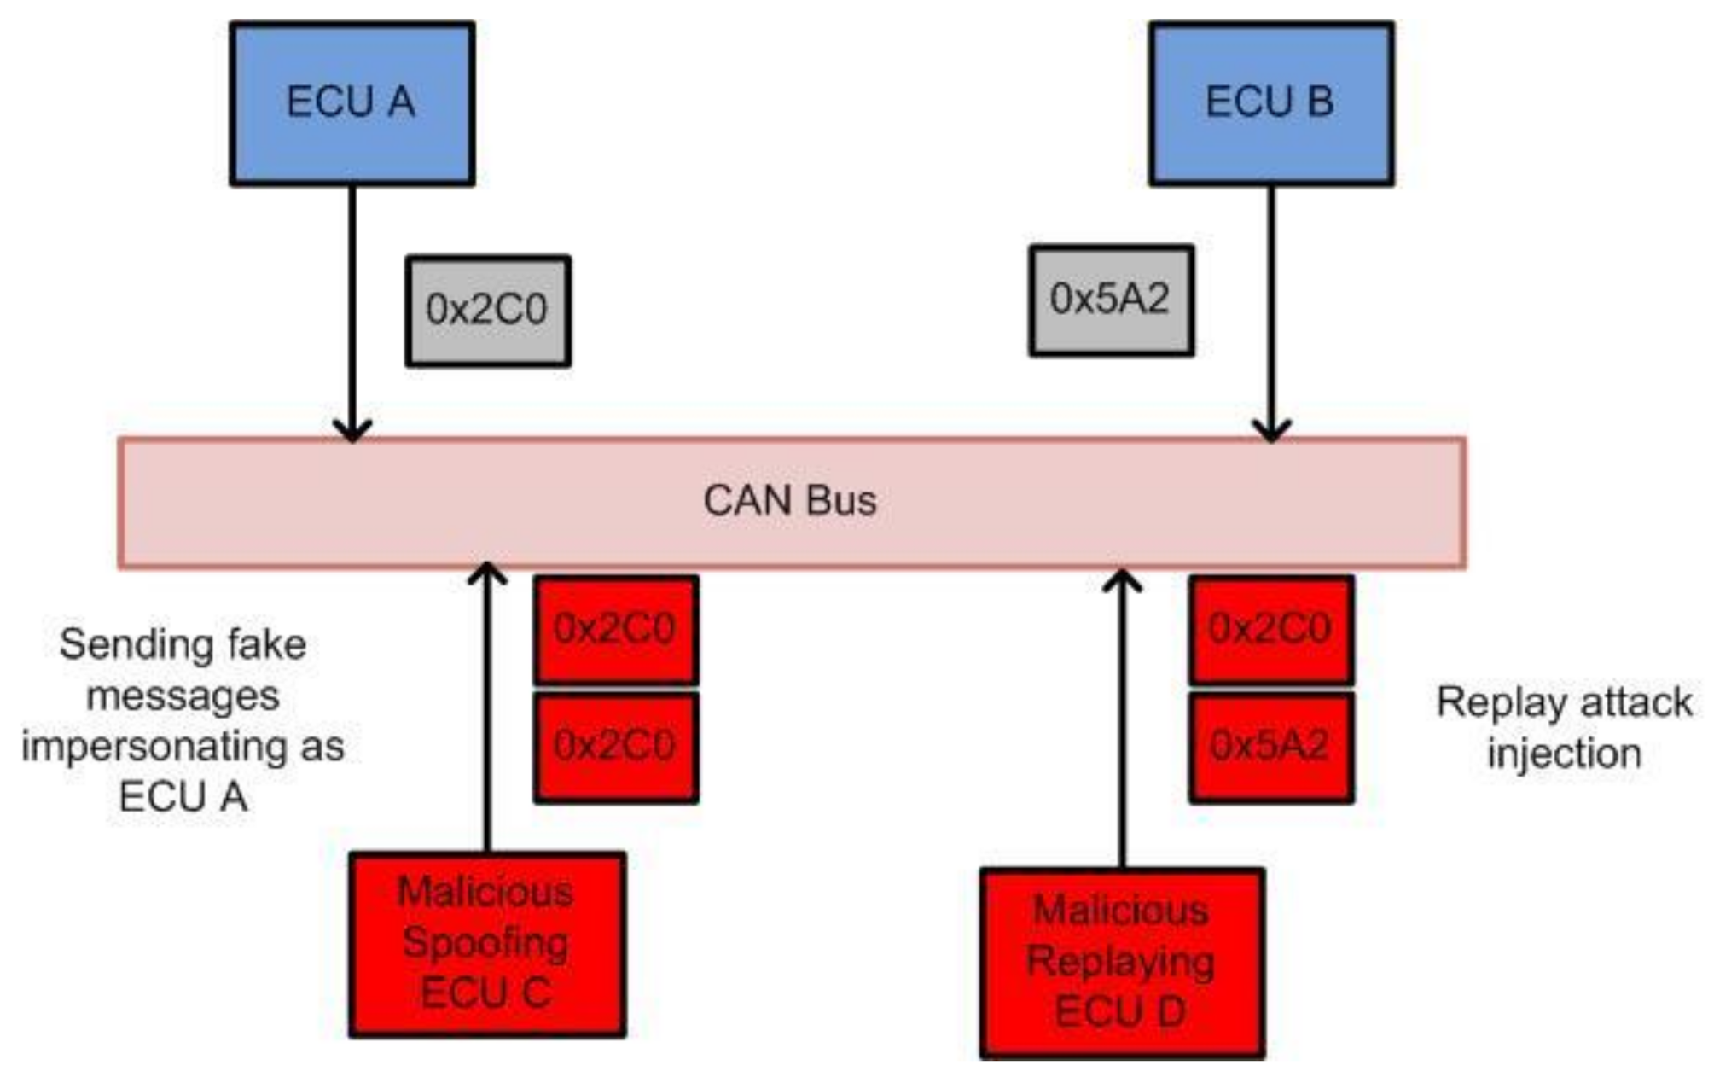
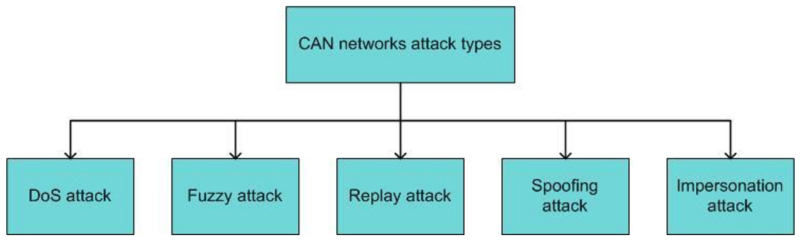
Security Issues in CAN
ID-Based Arbitration Mechanisms
Lack of Confidentiality
Lack of Authenticated Messages
Attacks on CAN bus – DoS, Fuzzing, Impersonation and Replay
Fig. 2 CAN attack types [9]
Fig. 3 a)DoS b) Fuzzing c) Spoofing [9]
Notes:
ID-Based Arbitration Mechanisms
When two or more nodes are transmitting messages on the bus, the node with a lower ID value will have higher priority. When a node on the bus observes a higher priority message, it stops transmission and backs off. With this arbitration mechanism, the CAN bus is vulnerable to a denial of service (DoS) attack. Hackers can send high-priority messages within a short interval of time causing the legitimate node to stop transmission
Lack of Confidentiality
The CAN protocol broadcasts frames over the bus, and every node connected to the bus can decide whether to accept or reject the message. Therefore, a malicious node can keep track of all the messages flowing on the bus. Messages are not encrypted in CAN bus networks. As a result, every node can see the messages passing through the bus. Attackers can analyze those messages and use them to hack into the in-vehicle network.
Lack of Authenticated Messages
Since the CAN frame format does not contain sender and receiver information, the receiver of the message cannot determine if a message is from a legitimate source or not. Thus, the authenticity of the message cannot be guaranteed in CAN networks.
Possible attacks on CAN bus

Slide 5
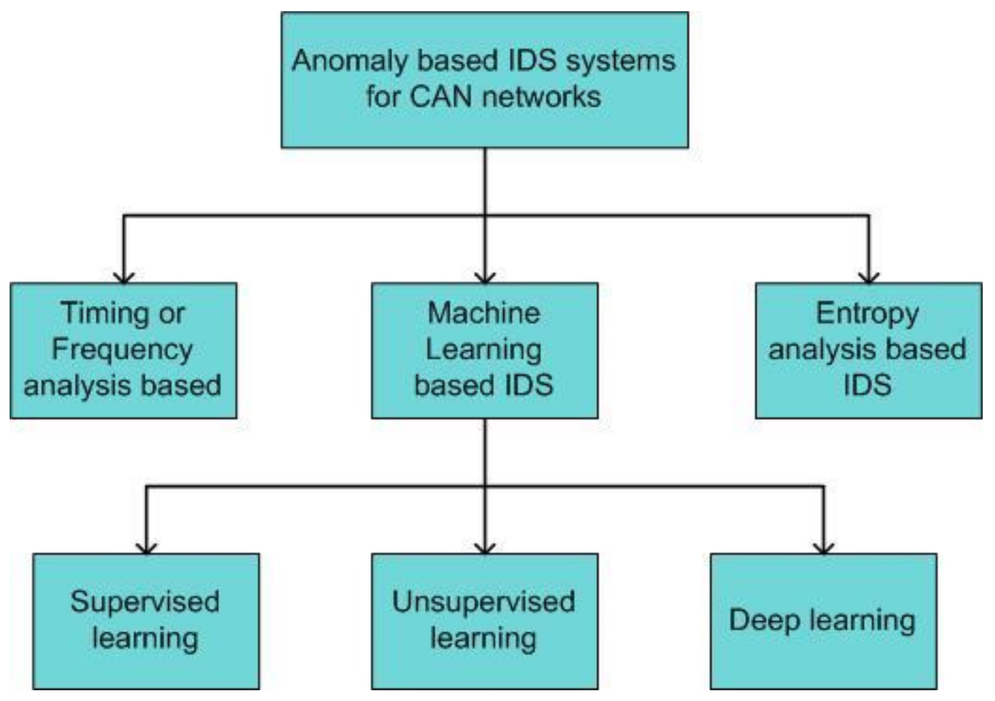
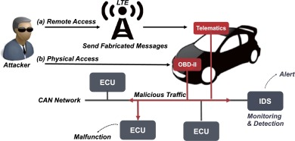
NIDS for CAN
Fig. 5 CAN Attack medium [2]
Fig. 4 IDS for CAN [9]
Notes:
CAN NIDS detects intrusions and potential cyber-attacks on the CAN bus system.
CAN NIDS can analyze the network traffic on the CAN bus system to detect anomalies or patterns that may indicate a malicious attack.
The CAN bus system uses ML/DL models as NIDS.
Recent research has shown that adversarial attacks can exploit these ML/DL models by intentionally producing perturbations over normal inputs.
Adversarial attacks have been created against ML/DL algorithms in different domains, including images, the real world, and malware.
Most adversarial attacks on NIDS have focused on directly changing network properties.
Feature-level adversarial attacks only alter traffic features and are not practical as they cannot be directly replayed in the network to carry out malicious operations.
Effective adversarial attacks should take into account packet space modifications that target NIDS.

Slide 6
Related Work
Authors | Model(s) | Dataset(s) | Features | Attack type | Performance
Kang et al. | DNN using pre-trained DBN | Generated by OCTANE software | CAN ID, DATA field | Normal/attack | 95%
Seo et al. | GAN | Hyundai’s YF Sonata vehicle | patterns of CAN IDs. Converted extracted CAN IDs into a simple image by encoding with one-hot-vector. | DoS, Fuzzy, RPM, and Gear attacks | 95%
Zhang et al. | DL (anomaly detection) | Collected data on the real intelligent vehicle CAN bus using KvaserCAN Leaf Light V2 | Extracted features using Busmaster from CAN log file (timestamp, ID, rpm, speed , throttle etc.) | spoofing and replay attacks. | 97.0% and 98.0%
Zhu et al. | LSTM (anomaly based) | Collected from real vehicle | Time, data | spoofing, replay, and flooding attacks | 80%
Song et al. | DCNN InceptionResnet | Created and publicly available HCRL dataset | transforms a CAN ID sequence into a 2-D grid data frame. | DoS, fuzzing, gear, and RPM | 80%
ADVERSARIAL ATTACKS RELATED NIDS
WISA (Choi, J et al.) | Inception Resnet | hcrl car-hacking dataset | transforms a CAN ID sequence into a 2-D grid data frame. | DoS, Fuzzy, Spoofing | Other measures
LM (anonymous) | AutoEncoder | Self-generated | Network traffic features | DoS, Fuzzy, Spoofing, Impersonation

Slide 7
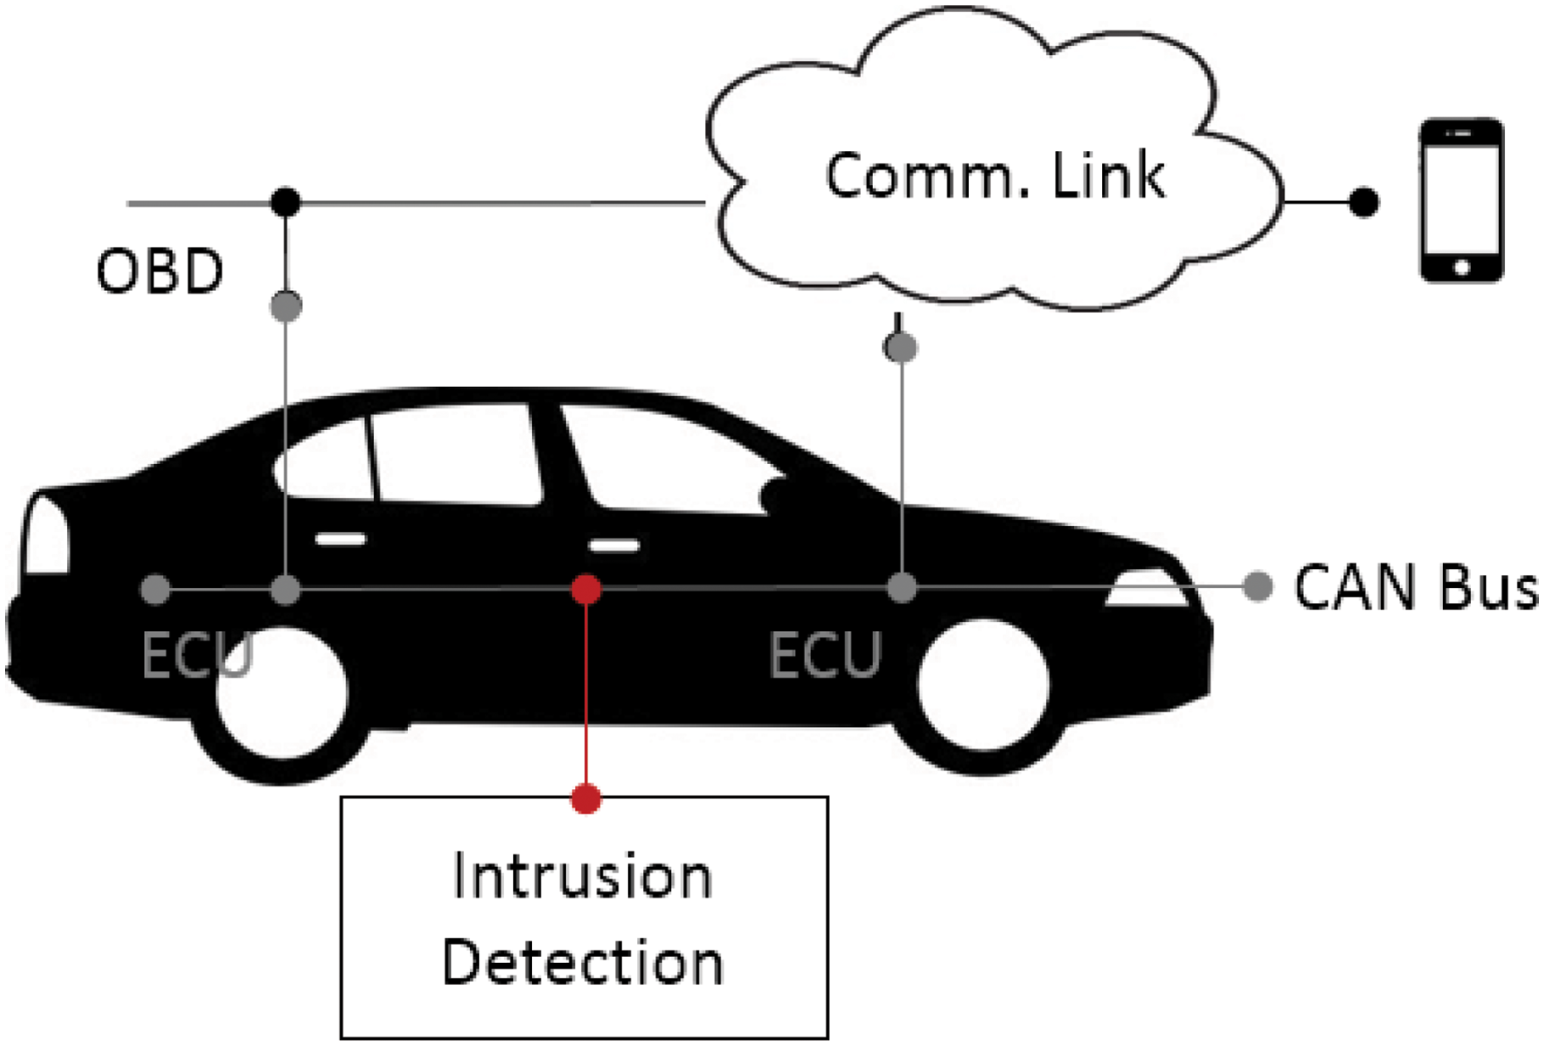
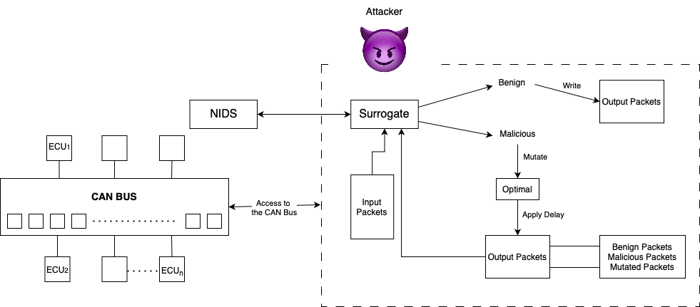
System Model
Fig. 6 System Model

Slide 8
Threat Model
Goal – The attacker wants the malicious packets to be classified as benign.
Knowledge – The attacker operates under a grey box setting where it does not have the complete knowledge of the network features but knows the possible model used.
Capabilities – Sniff and inject traffic from as no authentication and encryption present
Notes:
Goal – The attacker wants the malicious packets to be classified as benign.
Knowledge – The attacker operates under a grey box setting where it does not have the complete knowledge of the network features but knows the possible model used.
Capabilities
The attacker can sniff both normal and malicious traffic since they have access to the CAN Bus. Because CAN lacks encryption and authentication, packets can be easily intercepted.
The attacker has the ability to change adverse traffic, insert forged packets, and then replay the changed traffic throughout the network.
It is presumed that the attacker has had access to the on-board diagnostic (OBD-II) port or other remote network channels utilizing the vehicle's OBU for an infinite period of time.
A surrogate NIDS that closely resembles the target NIDS's decision boundaries can be created in the attack scenario's grey box setting even when the attacker is unaware of the target NIDS's specifics.
It is believed that the target NIDS will also categorise the packet as malicious or benign if the surrogate model has classified it as such. This is the attribute of transferability.

Slide 9
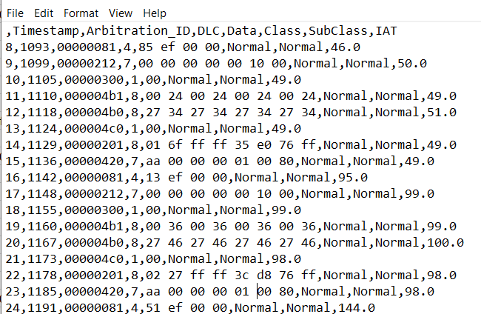
Proposed Solution
Dataset Description
HCRL CAR Hacking Dataset
NIDS
Type | Number of Packets
Normal | 91149
DoS | 20498
Fuzzy | 464
Impersonation | 172
Replay | 168
Fig. 7 Proposed Framework

Slide 10
Areas to Cover
Semantic Preserving Mutation
Genetic algo
Optimization algo
Surrogate NIDS
Literature survey
Practicality
logically
Using Testbed
Model selection

Slide 11
Mutations Performed
Timestamp based Mutation
Random Delay
Range Based Delay
Content Based Mutation
IAT based Delay
Changing ID
Mutations Performed
Changing Data
Combined Approach
Changed ID + Delay
Changed Data + Delay

Slide 12
Delay as Mutation
Model Used : Decision Tree, Random Forest
Data Pre-Processing : Add Inter_Arrival_time, change Data and ID from hex to decimal, avg scaling
Model training - 80%-20% split
Mutation performed on malicious traffic only
Delay added to the malicious packet’s timestamp field - Random/Range based/IAT based delay
Then this mutated traffic (delay added in original traffic) is sent to NIDS again, to check the effect of delay addition on the decision of NIDS.
Notes:
between (low, high) value where low = Mean inter-arrival time of all the traffic of an ID in benign setting and high = Mean Inter arrival time of packets of an ID in the presence of attack traffic.

Slide 13
Completed Evaluation
Model | Ideal Performance | Adversarial Performance
DT | 1.0 | 0.67
RF | 0.9984 | 0.6995
LSTM | 0.99805 | TBD
XGBoost | 0.998 | TBD
MLP | 0.9983 | TBD
Fig. 8 Results obtained

Slide 14
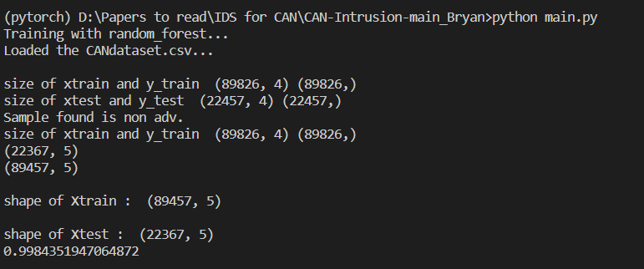
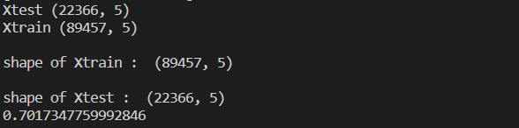
Completed Evaluation
Models used : Decision Trees and Random Forest
Model | Accuracy | Random Delay | IAT Based Delay | Accuracy after changing ID for DoS | Accuracy after changing Data for DoS | Delay + Data as mutation | Delay + ID as mutation
DT | 1.0 | 0.67 | 0.70 | 0.67 | 0.67 | 0.67 | 0.67
Table. I Accuracies across different mutations
RF accuracy before mutation
RF accuracy after IAT based delay

Slide 15
FNR = FN / (FN + TP)
Model | FNR without mutation | FNR after changing ID for DoS | FNR after changing Data for DoS | Random Delay | IAT Based Delay | Delay + Data as mutation | Delay + ID as mutation
DT

Slide 16
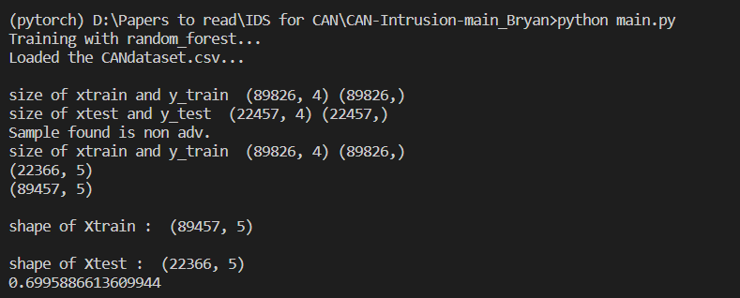
RF accuracy before mutation
RF accuracy after IAT based delay
RF accuracy after random delay

Slide 17
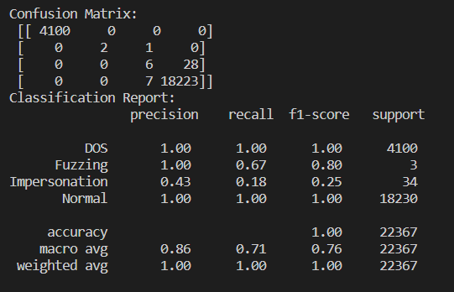
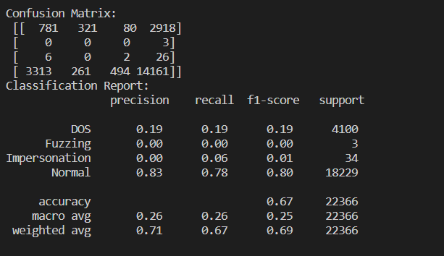
Random Delay
DT Performance – Before Mutation
DT Performance – After Mutation
DoS - 0
Fuzzing – 0.33
Impersonation – 0.8235
Normal – 0.0004
DoS – 0.7916
Fuzzing – 1.0
Impersonation – 0.75
Normal – 0.2126
FNR = FN / (FN + TP)
FNR rate of all types of packets increased except Impersonation and maximum impact on DoS packets

Slide 18
Random Delay
DT Performance before mutation
DT Performance after mutation
DoS - 0
Fuzzing – 0.33
Impersonation – 0.8235
Normal - 0.0004
DoS - 0.7916
Fuzzing – 1.0
Impersonation - 0.75
Normal - 0.2126

Slide 19
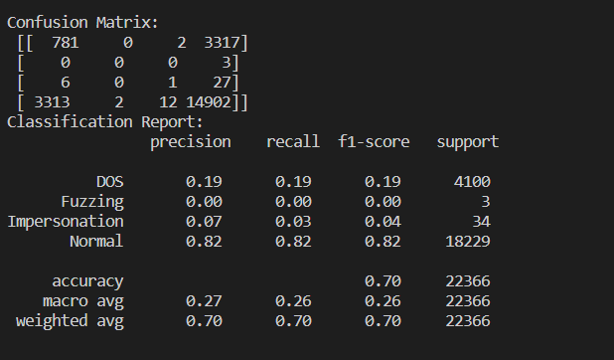
IAT Based Delay
DT Performance before mutation
DT Performance after delay on DoS
DoS - 0
Fuzzing – 0.33
Impersonation – 0.8235
Normal - 0.0004
DoS - 0.8093
Fuzzing – 1.0
Impersonation – 0.9629
Normal - 0.5181

Slide 20
IAT Based Delay
DT Performance – Before Mutation
DT Performance – After Mutation
DoS - 0
Fuzzing – 0.33
Impersonation – 0.8235
Normal – 0.0004
DoS – 0.8093
Fuzzing – 1.0
Impersonation – 0.9629
Normal – 0.5181
FNR rate of all types of packets increased, maximum impact on DoS packets

Slide 21
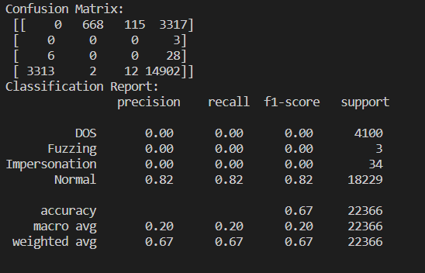
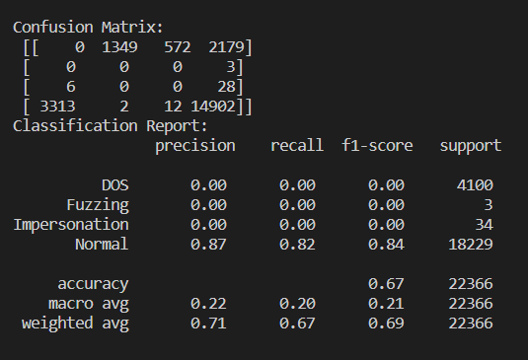
Effect of ID and Data Change
DT Performance – ID Change
DT Performance – Data Change
DoS - 1.0
Fuzzing – 1.0
Impersonation – 1.0
Normal – 0.1817
DoS - 1.0
Fuzzing – 1.0
Impersonation – 1.0
Normal - 0.1817
DoS packets misclassification 16.29% -> Fuzzing
2.80% -> Impersonation
80% -> benign
DoS packets misclassification 32.90% -> Fuzzing
13.95% -> Impersonation
53.14% -> benign
Changing ID is more closed to benign behavior than Changing Data

Slide 22
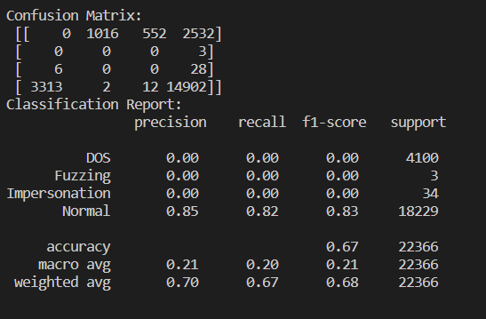
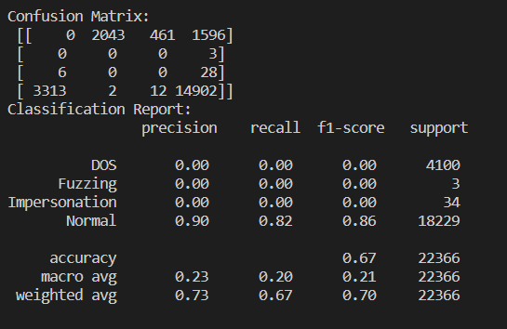
FNR with Delay Mutation with ID and Data Change
DT Performance – ID Change
DT Performance – Data Change
DoS - 1.0
Fuzzing – 1.0
Impersonation – 1.0
Normal – 0.1817
DoS - 1.0
Fuzzing – 1.0
Impersonation – 1.0
Normal – 0.1817
DoS packets misclassification 24% -> Fuzzing
13.5% -> Impersonation
62% -> benign
DoS packets misclassification 49.8% -> Fuzzing
11.24% -> Impersonation
38.9% -> benign
Adding Delay should increase misclassification to benign, but it actually increases misclassification to other attack types.

Slide 23

Conclusion
For Timestamp based mutation - Adding IAT-based delay is more effective than adding Random Delay.
For Content based mutation - ID based mutation is more effective than Data based mutation.
For a combined approach based mutation adding IAT-based Delay works better with mutated ID.
Accuracy of the model may not be a good measure of performance for an NIDS.
Goal of the attacker was to classify the attack packet into benign, but it also classify one attack type into another.
In case of DDoS or Impersonation of multiple IDs, the model may perform differently.
Notes:
Add sequence transition to the sentences

Slide 24
Questions to Ponder!
Does the misclassification into another attack type (not as benign) matter for an NIDS?
01
How will the NIDS perform in case of Distributed DoS/Impersonation?
02
Does the Order or Sequence of CAN messages matter for prediction?
03
How will delay work with aperiodic IDs of CAN messages?
04

Slide 25
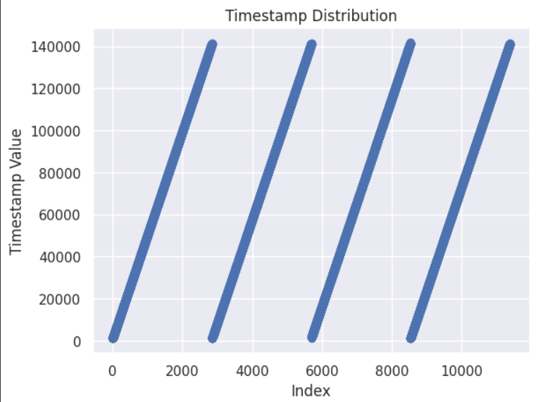
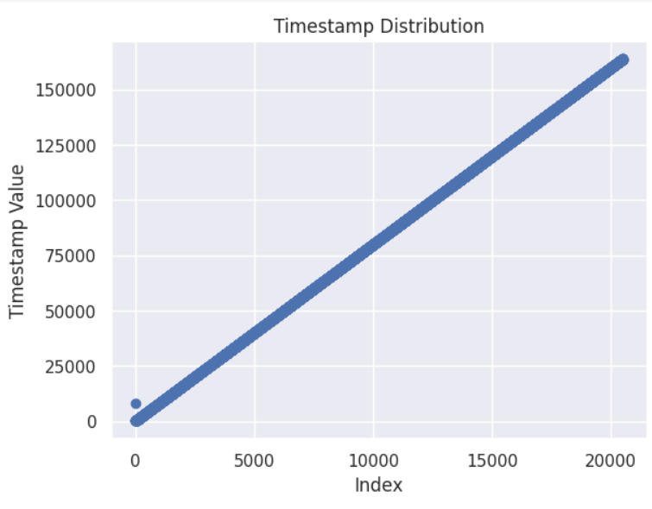
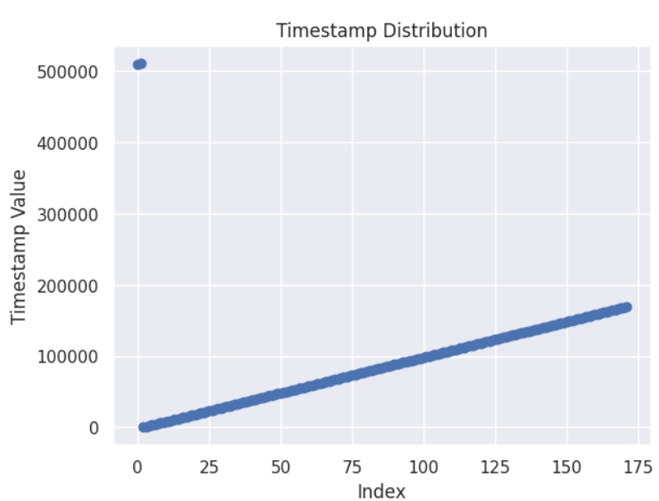
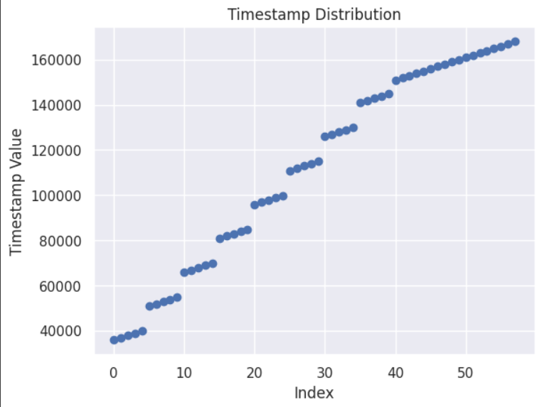
Planned Evaluation
Use of Anomaly detector than a classification model because in real systems the attacks are assumed to be unknown and could not be used to train the model beforehand.
Delay strategy apart from Random Delay
Plotting timestamp distribution of each attack traffic, projecting it to the distribution of normal traffic.
Timestamp Distribution of a) Normal b) DoS c) Impersonation d) Replay traffic
Notes:
Checking the importance of each input feature given to the model. Based on the importance, I would select the parameter to be mutated. This could include extracting statistical features from the existing features for better performance.
To use Anomaly detector than a classification model because in real systems the attacks are assumed to be unknown and could not be used to train the model beforehand.
To find out how much delay is optimal in order to see a change in the performance of prediction. This could be achieved by plotting Inter arrival time of each ECU ID, then projecting it to another distribution.

Slide 26
References
[1] T.J. Park, C.S. Han, and S.H. Lee, "Development of the electronic control unit for the rack-actuating steer-by-wire using the hardware-in-the-loop simulation system," Mechatronics, vol. 15, no. 8, pp. 899-918, 2005.
[2] F. Yu, D.F. Li, and D. Crolla, "Integrated vehicle dynamics control—state-of-the art review," in Proceedings of the Vehicle Power and Propulsion Conference, IEEE, 2008.
[3] Cyber-attacks over CAN must be avoided because they pose a serious risk to the safety of drivers. To identify suspicious communications over CAN, many intrusion detection systems (IDS) have been developed [3].
[4] C. Miller and C. Valasek, "Remote exploitation of an unaltered passenger vehicle."
[5] R. Kemmerer and G. Vigna, "Intrusion detection: a brief history and overview," Computer, vol. 35, no. 4, pp. 27-30, 2002.
[6] O. Ibitoye, R. Abou-Khamis, A. Matrawy, and M.O. Shafiq, "The threat of adversarial attacks on machine learning in network security-a survey," arXiv preprint arXiv:1911.02621, 2019.
[7] A. Kurakin, I. Goodfellow, and S. Bengio, "Adversarial examples in the physical world," arXiv preprint arXiv:1607.02533, 2016.
[8] W. Hu and Y. Tan, "Generating adversarial malware examples for black-box attacks based on gan," arXiv preprint arXiv:1702.05983, 2017.
[9] Khatri, N., Shrestha, R., & Nam, S. Y. (2021). Security issues with in-vehicle networks, and enhanced countermeasures based on blockchain. Electronics, 10(8), 893.

Slide 27
Thank You.

